Slide 1
Sensor Hub v01
Mechanical

Slide 2
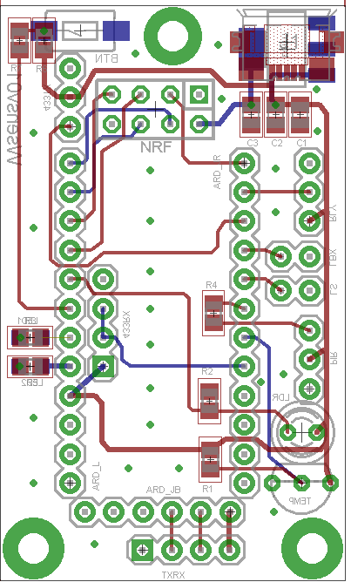
eyes
TOP LAYER
BOTTOM LAYER

Slide 3
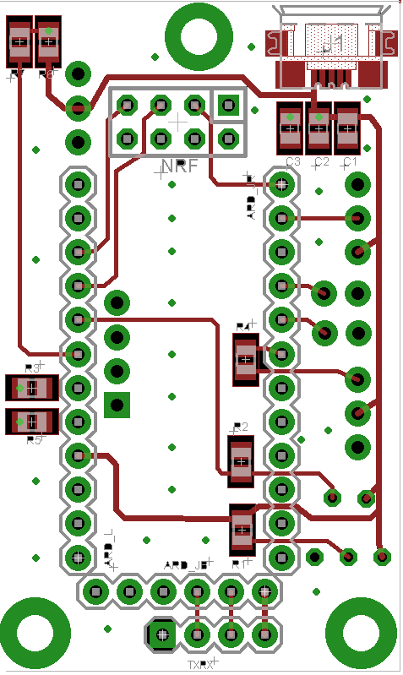
TOP
NRF
Micro USB
Arduino Pro Mini
eyes
TOP LAYER

Slide 4
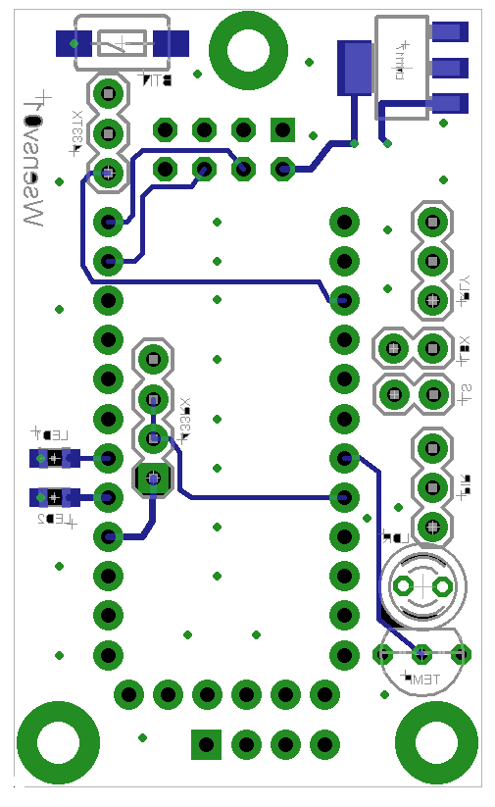
BOTTOM
SMT Button
5v -> 3.3v
433TX
Relay
433RX
LED Box
LED Strip
Debug led
Debug led
Motion
Light
Temp
eyes
important
BOTTOM LAYER

